Slide 1
Lightning Talk 1 - Product Research
sdmay25-16

Slide 2
Project Overview
Problem Statement: Design and build an 8/16 channel amplifier with little noise to boost ultrasound signals received for the acoustic imaging system.
Constraints:
Low noise
Low input impedance
Bandpass filtering: 10k-1M
Low size (< 5x5 cm)
ESD protection

Slide 3
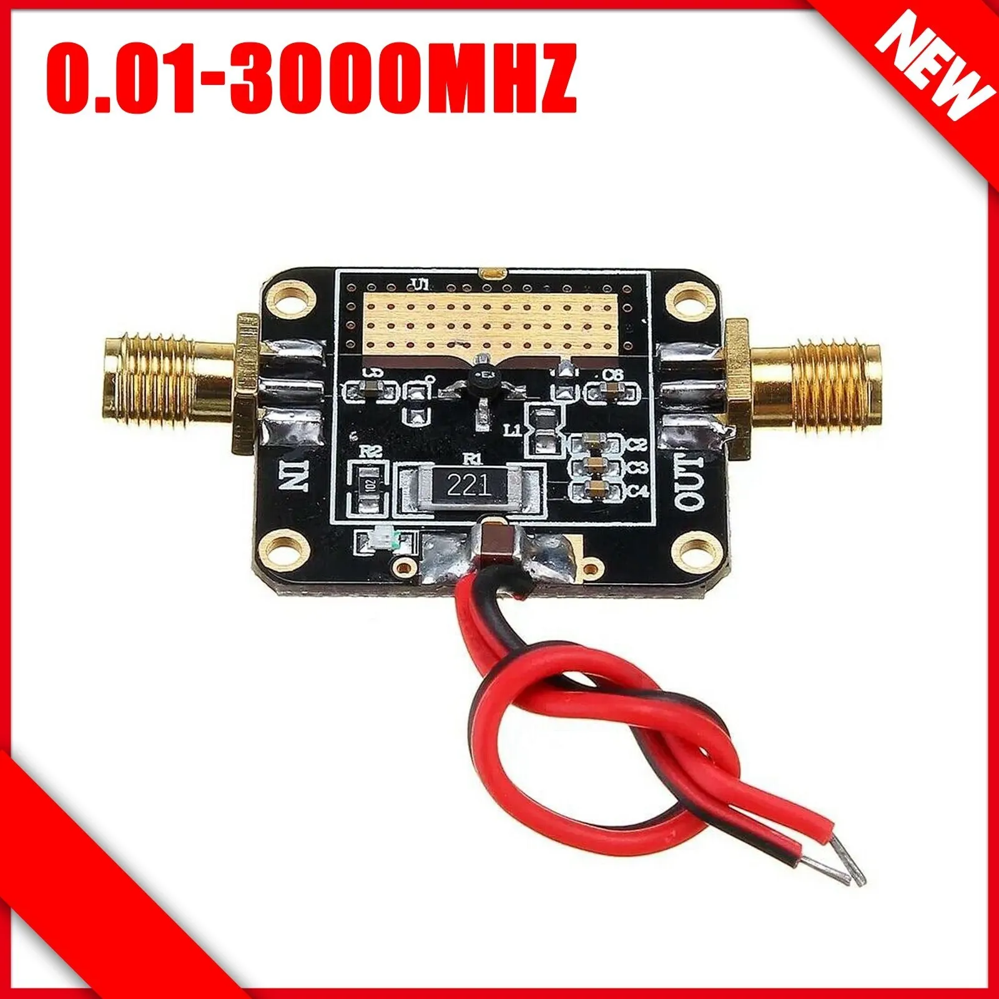
Competition in the Market
RF 0.01-3000 MH​z LNA Wideband Amplifier High Gain Low-noise Amplification Module
Higher end of frequency band
12V input
RF input/output
$12.59 per board
22dB gain
Link

Slide 4
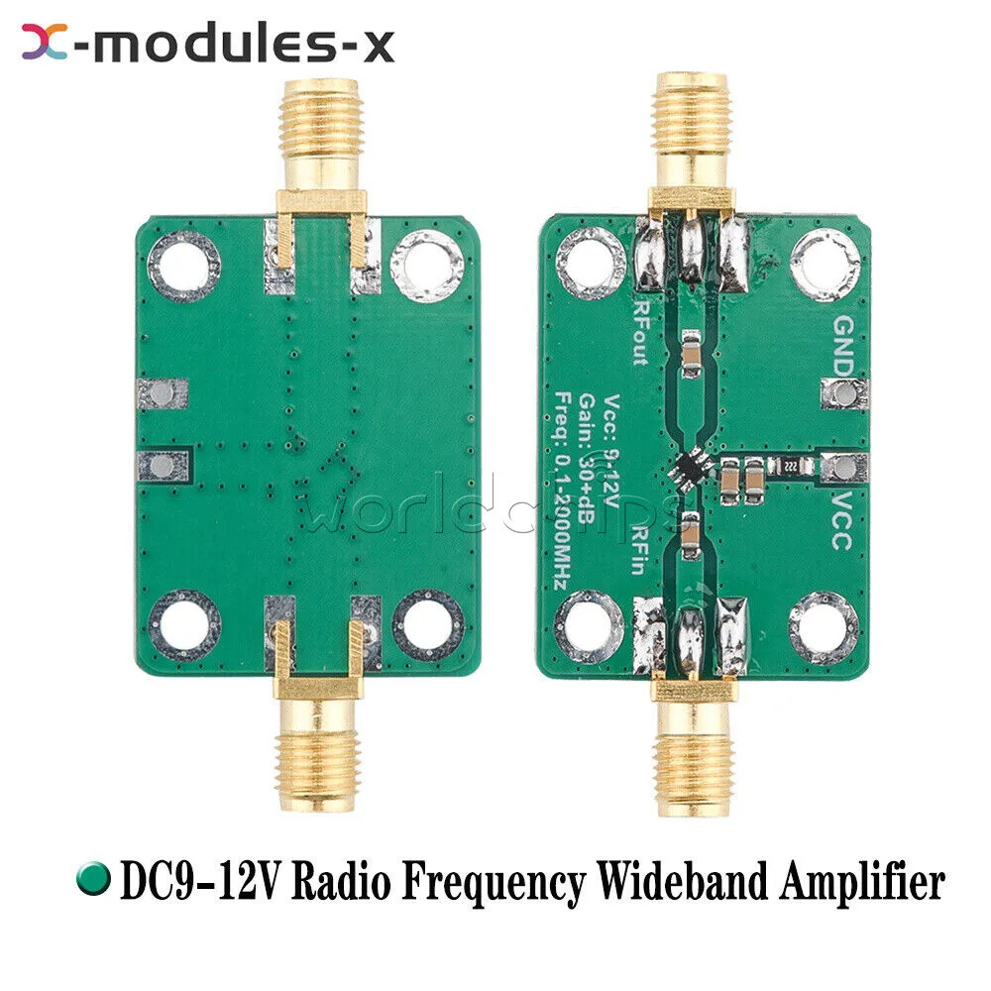
Competition in the Market
RF Wideband Amplifier Low-noise LNA Broadband Module Gain 32dB 0.1-2000MH​z USA
Different Frequency Band
32dB gain
12V input
RF input/output
$7.84 per board
Link

Slide 5
Market Gap
We aim to power using a 5V input which is more common and more useful for a lot of the lab work done here
Modularity a big focus so it can be customizable and flexible to changes in application
Plan to make it multi-stage for a higher gain
Cost and manufacturability

Slide 6
Conclusions & New Ideas from Research
Thinking about the application and what needs to be done differently for it to work for the photoacoustic sensor
Picked up how we want the silkscreen to look based off of the other designs
Honed in on what we liked and didn’t like about the similar products on the market
Consistencies between products showed us things we didn’t think about that we needed in the design

